Slide 1

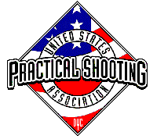
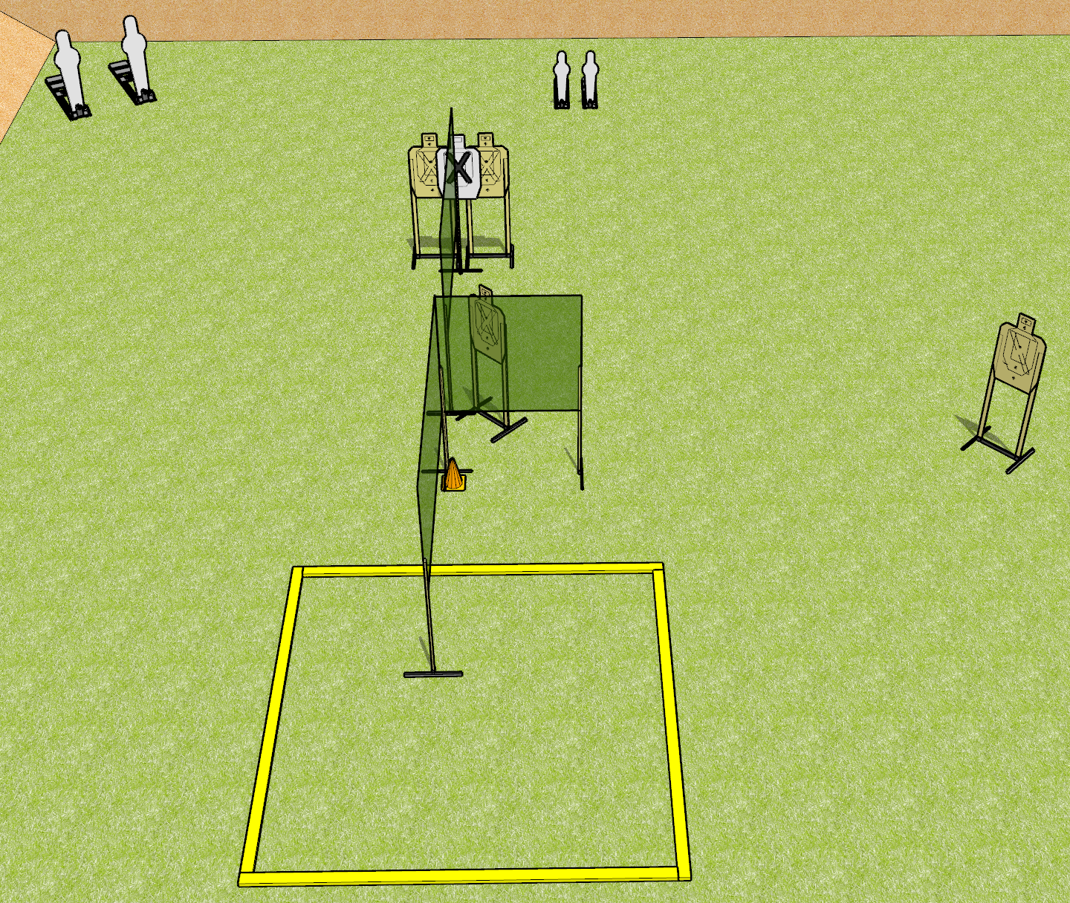
 | Dothan Gun Club – USPSA Match Triple Kill Course Designer : Drew Coleman
START POSITION : Standing anywhere outside the shooting area.
GUN READY CONDITION : Pistol loaded and holstered. PCC shouldered, safety on, pointed at orange cone. |  | SCORING: Comstock, 16 rounds TARGETS: 4 paper, 4 Steel SCORED HITS: Best 3 on paper, steel until down START-STOP: Audible, last shot RULES:
STAGE PROCEDURE: Engage targets as they become available from within the fault lines. Make a mandatory reload prior to last shot fired.

